Slide 1
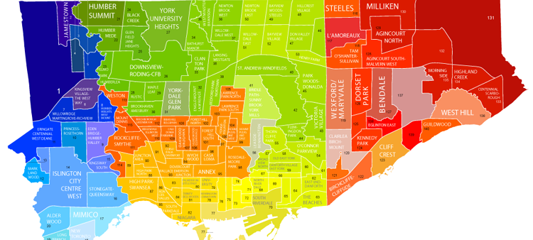
THE BATTLES OF NEIGHBORHOODS
Neighborhood of choice for ABC Grocery’s first venture in Toronto.

Slide 2
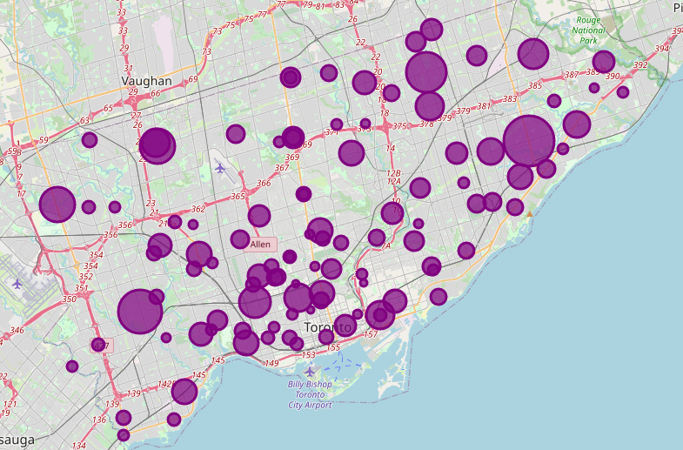
INTRODUCTION
Toronto City Pharmacy Overview
Orange Drugs Strategic Plan
Orange Drugs Startup Problem
Choice of the first neighborhood to offer services.
The neighborhood should have high demand.
The neighborhood should have lower competition.
Large Market and Customers Possibilities
Success Criteria:
Neighborhood that meets above points.

Slide 3
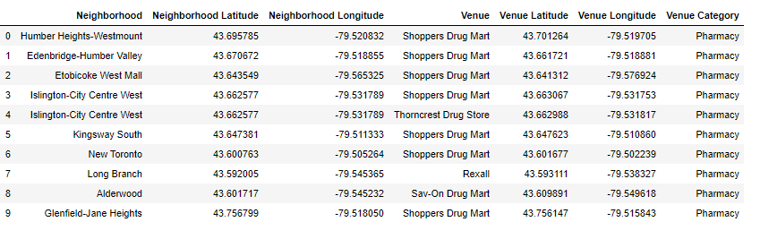
DATA DESCRIPTION
Data Requirements
Neighborhoods
Venues
Hospitals Data
Demographics Data
Data Sources
Wikipedia Pages
Foursquare API
Toronto Health Profiles
Cmhc-schl.gc.ca
Data Processing
Cleaning
Merging

Slide 4
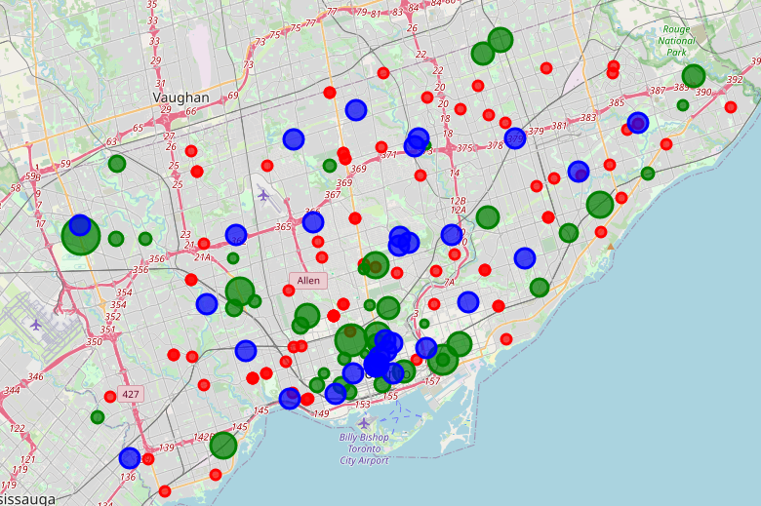
METHODOLOGY
Data Scrapping Technique
Scraping Hospitals Data from Wikipedia
Data into a structured format
Integrating Geolocations
Foursquare API
Retrieving Venues Information
Folium
Visualizing in Maps
Analyzing Neighbourhood
Evaluation
Least Competition
High Demand

Slide 5
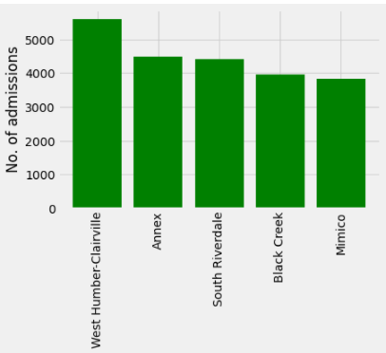
RESULT
Neighborhood without Pharmacies
Sorting with high admission
Least Competition
Nearby Hospitals

Slide 6
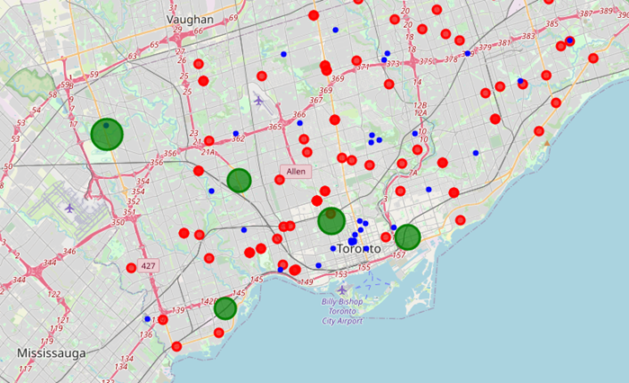
DISCUSSION
Result Review:
Identifying Least Competition Neighborhoods
West Humber-Clairville is the first Neighbor with least competition
High Admission Rate
Large Market Possibilities

Slide 7
CONCLUSION
Recommendation Summary:
Region: North-West of Toronto.
Neighborhood: West Humber-Clairville.
Additional Offering: Large Future Possibilities.
Honorable Neighborhoods:
South River Dale
Black Creek.

